Slide 1

Binary Search Trees
Fundamentals of Algorithms
Lecture 10

Slide 2
Search Trees
Search trees are data structures that support many dynamic set operations, including search, minimum, maximum, successor, predecessor, insert and delete.
A search tree can be used as a dictionary.

Slide 3
Binary Search Tree
A binary search tree is a binary tree, where each node has left or right child. Either or both children may be missing.
In addition to a key field, each node contains fields left, right and p, that correspond to its left child, right child and its parent.

Slide 4
Contd…
If a child or parent is missing, the appropriate field contains the value NIL.
The root is only node in the tree, whose parent field is NIL.
Top of the tree is known as ‘root’ and the exposed nodes at bottom are known as ‘leafs’.

Slide 5
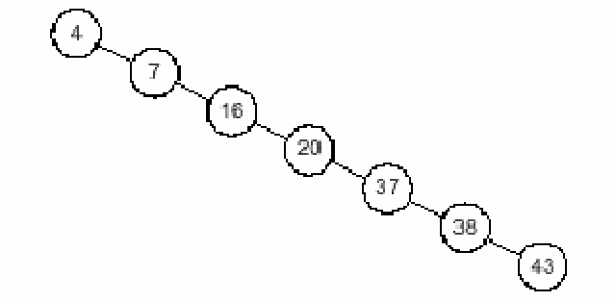
An Unbalanced BST
In this tree, root is node 4 and leaf is node 43
Height of the tree is 6.

Slide 6
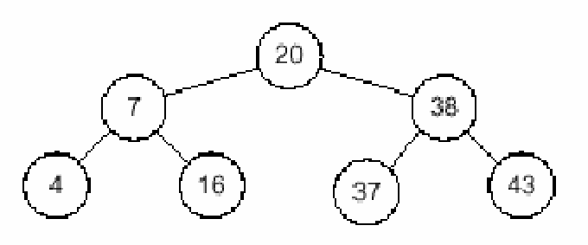
Binary search tree property
Assuming k represents the value of a given node, then a BST also has the following property
“all children to the left of the node have smaller values than k and all children to the right of the node have larger or equal values than k”

Slide 7
In Order tree walk
The BST property allows us to print out all keys in BST in sorted order using a simple recursive algorithm.
InOrder_Tree_Walk(x)
if x≠ NIL
then InOrder_Tree_Walk(left[x])
print key[x]
InOrder_Tree_Walk(right[x])

Slide 8
In Order tree walk
4, 7, 16, 20, 37, 38, 43

Slide 9
Querying a BST
Want to search for key stored in BST
Functions:
    Tree search
    Minimum
    Maximum
    Successor
    Predecessor

Slide 10
Searching
When given a pointer to the root of a tree and a key, Tree-Search will return a pointer to the node with key k if one exists (x = root).
Tree-Search (x, k)
if x=NIL or k=key[ x]
then return x
if k<key [x]
then return Tree-Search( left[ x], k)
else return Tree-Search( right[ x], k)

Slide 11
Contd…
This function follows the BST property, if value of k is smaller than that of x, then it should be in left sub tree of x, else it should be in right sub tree of x.
The running time of the search operation is O( h), where h is the height of BST.

Slide 12
Searching a BST
46
17
63
2
25
97
To search for 25, go to the root node.
Compare 25 with the value at the root node.
25 < 46 => the desired node is located in the left subtree, with root = 17.

Slide 13
Searching a BST
17
2
25
Compare 25 with the value at the root node.
25 > 17 => the desired node is located in the right subtree.
Examining the one-node right subtree locates the value 25.

Slide 14
Inserting into a BST
A BST can be built by repeatedly calling a function to insert elements into a BST, that is initially empty.
=> root is null pointer.
The method to determine where an element has to be inserted is the same as search.
A pointer has to be maintained, which will point to the parent of the currently examined node.

Slide 15
Inserting into a BST
root
O
E
T
C
M
P
U
To insert the letter ‘R’
Begin at the root.
Since ‘R’ > ‘O’, descend to the right subtree.

Slide 16
Inserting into a BST
root
locptr
O
E
T
C
M
P
U
The locptr points at the current location being examined.
Point the parent to the locptr.
Point locptr to the right child.

Slide 17
Inserting into a BST
root
parent
O
E
T
locptr
C
M
P
U
Compare ‘R’ with ‘T’.
Since ‘R’ < ‘T’, descend to the left subtree.
Point parent to ‘T’
Point locptr to ‘P’.

Slide 18
Inserting into a BST
root
O
E
locptr
T
parent
C
M
P
U
Compare ‘R’ with ‘P’.
Since ‘R’ > ‘P’, descend to the right subtree.
But the right subtree of ‘P’ is empty.
=> ‘R’ should be inserted to the right of ‘P’

Slide 19
Inserting into a BST
root
O
E
parent
T
C
M
P
U
R

Slide 20
Example: Validating Computer Logins
Consider the problem of organizing a collection of computer user-id and passwords.
Each user logs in to the system by entering his/her user-id and secret password.
The system checks the validity of user-id and password to verify that this is a legitimate user.

Slide 21
Example: Validating Computer Logins
Sine validation must be done several times in a day therefore searching should be done rapidly.
This must be a dynamic structure since new users are added regularly to the system.
A BST can be used since it’s a dynamic structure and can be rapidly searched.

Slide 22
Example: Validating Computer Logins
The following steps can be followed:
Open a stream file containing the valid user information.
Read the user information from the file and insert them into a BST.
Repeat the following until shutdown:
  Read user-id and password.
  Search the BST for this object.
  If found display “success” message else display “failure” message.

Slide 23
Problem of Lopsidedness
The order in which items are inserted into a BST determine the shape of the tree.
For example, inserting the letter O,E,T,C,U,M,P gives a nicely balanced tree.
O
E
T
C
M
P
U

Slide 24
Problem of Lopsidedness
But inserting in the order C,O,M,P,U,T,E yield unbalanced tree.
C
O
M
P
E
U
T

Slide 25
Problem of Lopsidedness
Inserting in the alphabetical order C,E,M,O,P,U,T degenerates the tree into a linked list
C
E
M
O
P
T
U

Slide 26
Problem of Lopsidedness
The basic operations on a BST depend on the shape of the tree.
In a balanced BST, left and right subtrees of a node contain almost equal number of nodes.
Thus as the search pointer moves down the tree from one level to the next, the size of the subtree to be examined is reduced by one-half.
=> the search time in O(log₂n)
As the BST becomes increasingly unbalanced the performance of these functions deteriorates.

Slide 27
Problem of Lopsidedness
When the tree degenerates to a linked list the computing time become O(n).
It is usually not possible to determine the optimal order in which to insert items into a BST.
The usual solution is to rebalance the tree after each new element is inserted using rebalanced algorithms.

Slide 28
Minimum Function
The minimum element of BST is the left most node of left sub tree.
Therefore the minimum can always be found by tracking the left child pointers until an empty sub tree is reached.
Tree-Minimum( x)
while( left[ x] != NIL)
do x<-left [x]
return x
If there is no left sub tree then minimum key is at root( i.e. key[ x])

Slide 29
Maximum Function
The maximum element of BST is the right most node of right sub tree.
Therefore the maximum can always be found by tracking the right child pointers until an empty sub tree is reached.
Tree-Maximum( x)
while( right[ x] != NIL)
do x<-right [x]
return x

Slide 30
Successor Function
The successor of a node x, is node y, that has the smallest key greater than that of x.
If x has a right subtree, then successor(x) is the left most element in that sub tree.
If x has no right sub tree, then successor(x) is the lowest ancestor of x (above x on the path to the root) that has x in its left sub tree.

Slide 31
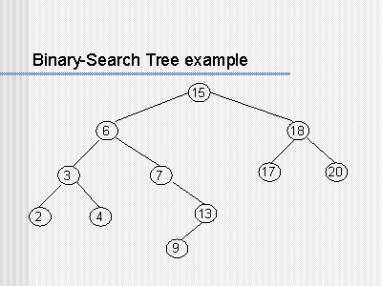

Slide 32
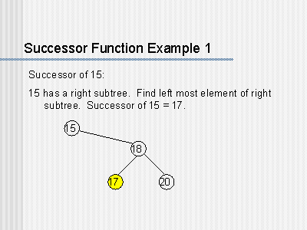

Slide 33
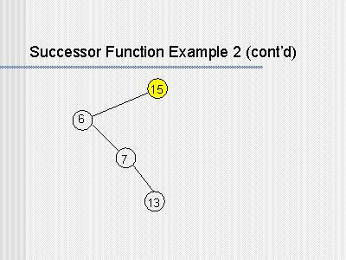
Successor of 13

Slide 34
Predecessor Function
The predecessor is the node that has the largest key smaller than that of x
If x has a left sub tree, then the predecessor must be the right most element of the left sub tree.
If x has no left subtree, then predecessor (x) is the lowest ancestor of x (above x on the path to the root) that has x in its right subtree.

Slide 36
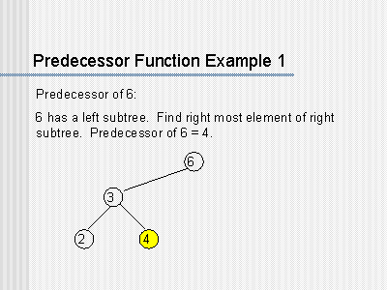

Slide 37
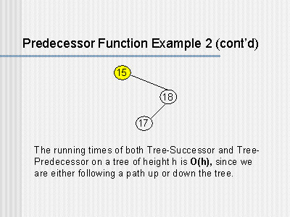
Predecessor of 17

Slide 38
Deletion
To delete a node x from a BST, three cases can be considered:
x is a leaf.
x has one child
x has two children
x is a leaf:
If x is the left child of its parent then make the left pointer of x’s parent a null pointer.
If x is the right child of its parent, then make the right pointer of x’s parent a null pointer.

Slide 39
Deletion
To delete the node containing I:
Make the left pointer of M a null pointer.
Return x to the heap
C
O
H
P
E
M
U
I
x
T

Slide 40
Deletion
x has one child:
Set the appropriate pointer in x’s parent point to the child of x.
Return x to the heap
C
O
H
P
E
M
x
U
I
T

Slide 41
Deletion
To delete a node x having two children:
This can be reduced to other two cases
the value in the node x is replaced by:
  Its inorder successor
  Or inorder predecessor
And then delete the successor or the predecessor accordingly.

Slide 42
Deletion
x has two children:
For example to delete J
Locate its successor, by starting at the right child of J.
Descend left as far as possible
G
x
F
J
A
H
O
E
I
M
P
C
K
N
B
D
L

Slide 43
Deletion
Replace J with K.
Adjust the pointer of K’s parent M.
G
K
x
F
J
A
H
O
E
I
M
P
C
K
N
B
D
L

